Slide 1

HISTORY OF THE EMERGENCE OF INDEPENDENT BANGLADESH
Dr. Md. Abdul Alim
B. A (Hon’s), M. A (History), M. Phil (Raj), Ph. D (Raj)
Email:doctorabdulalim64@gmail.com
Cell: +880 01718-787466

Slide 2
DISCUSSION CONTENTS
Introduction of Partition of Bengal 1905
Background of partition
Purpose of partition of Bengal or reasons for the partition of Bengal
Reaction to the partition of Bengal
Result of the partition of Bengal
Annulation of the partition of Bengal
Discussion on Mid-Term Exam-2023

Slide 3
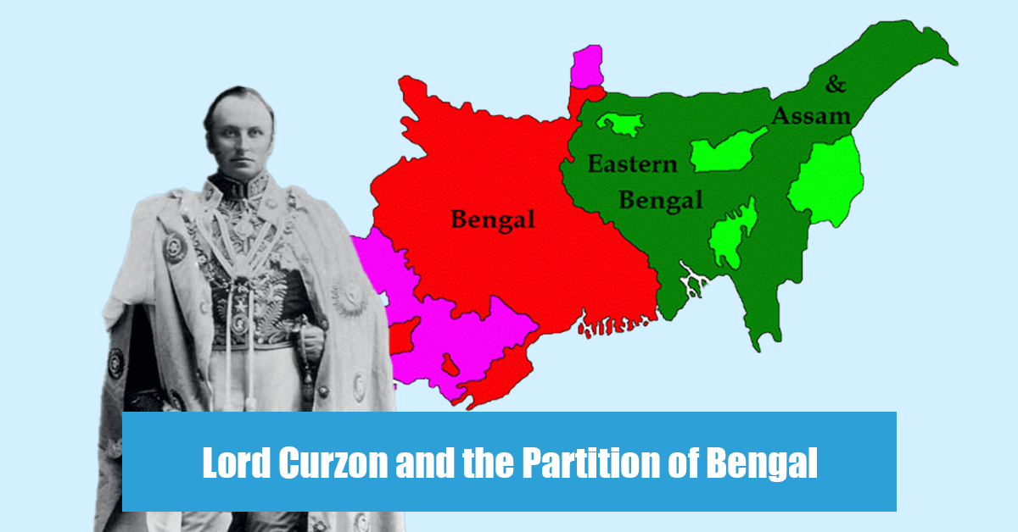
PARTITION OF BENGAL 1905
The Bengal Partition happened on October 16, 1905. The British Indian province of Bengal was partitioned by Lord Curzon, who was the Viceroy of India at the time, on October 16, 1905.

Slide 4
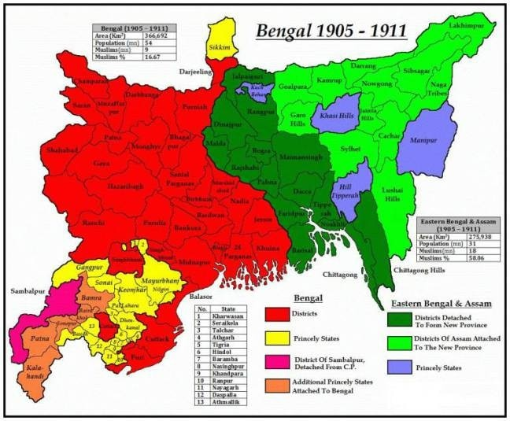
PARTITION OF BENGAL 1905
The partition was ultimately short-lived, and was annulled in 1911 after sustained protests and agitation from Indian nationalist leaders, including the famous "Swadeshi Movement." The partition also played a significant role in the growing political consciousness of the Indian people and served as a rallying point for the Indian nationalist movement.

Slide 5
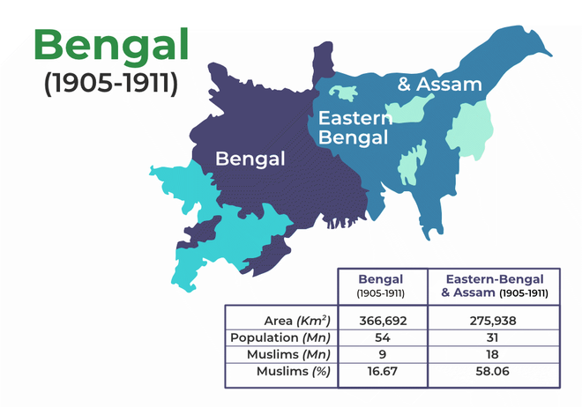
BACKGROUND & THE PARTITION
Since 1765 (following the Battle of Buxar) the province of Bengal, which included present-day West Bengal, Bihar, Odisha, Bangladesh, and Assam was under the British.
It was a very large area and the population rose to almost 80 million by the first few years of the 20th century. Calcutta was the capital of the province and also of British India.

Slide 6
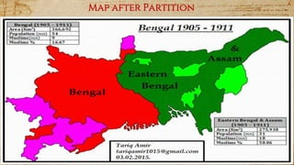
BACKGROUND & THE PARTITION
There were difficulties in administering such a large area. The eastern part, especially in rural areas was neglected.
That region was lacking in the fields of industry, education, and employment. Much of the industry was centered in Calcutta.
Initially, Lord Curzon solely proposed the province's partitioning as an administrative measure. In 1904, he undertook a tour of eastern Bengal.
As per Curzon, after the partition, the two provinces would be Bengal (including modern West Bengal, Odisha, and Bihar) and Eastern Bengal and Assam.

Slide 7
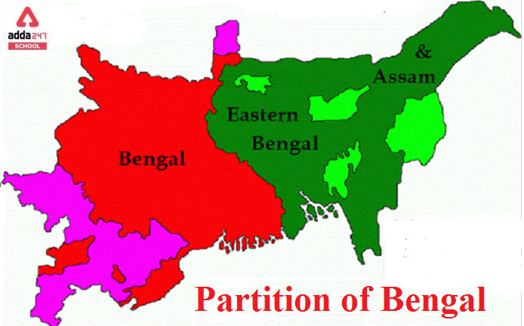
BACKGROUND & THE PARTITION
Bengal would also lose five Hindi-speaking states to the Central Provinces. It would gain Odia-speaking states from the Central Provinces.
Eastern Bengal would consist of Hill Tripura, Chittagong, Rajshahi, and Dhaka divisions. Its capital would be Dhaka.
Bengal would have a Hindu majority and Eastern Bengal and Assam would have a Muslim majority population. Its capital would remain Calcutta.

Slide 8
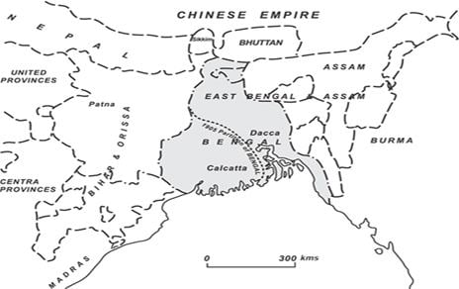
PURPOSE OF PARTITION OF BENGAL
The partition of Bengal in 1905 was primarily driven by the British colonial government's administrative and political considerations. The main purpose of the partition was to improve British administrative efficiency by dividing the large province of Bengal, which was difficult to govern effectively, into two more manageable provinces. The British also believed that the partition would help accelerate the economic development of the eastern region of Bengal by making it easier to access resources and provide better services.

Slide 9
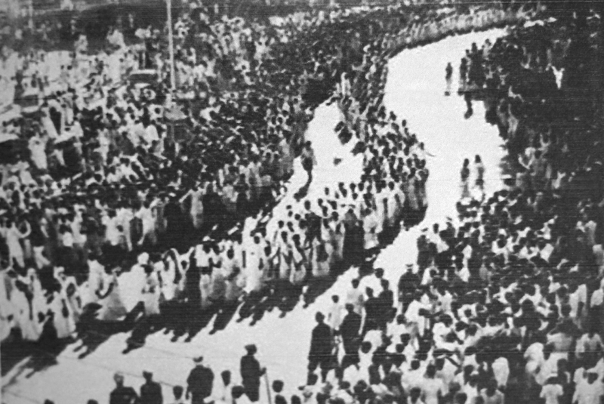
PURPOSE OF PARTITION OF BENGAL
However, there were also political motives behind the partition. The British government hoped that by dividing the Bengali Hindu and Muslim populations, they could weaken the growing nationalist movement in Bengal.
The partition was seen as a way to counter the growing political influence of Bengali Hindus, who were viewed as a threat to British rule. The British also hoped that the Muslim population in the eastern region of Bengal would be more supportive of their rule, as they were seen as a separate community that needed separate administrative representation.

Slide 10
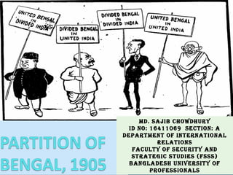
REASONS FOR THE PARTITION OF BENGAL
Administrative Convenience: The British believed that Bengal, which was the largest province in India, was too big to be governed efficiently. They thought that dividing it into two separate administrative units would make it easier to govern and provide better services to the people.
Economic Reasons: The British felt that the eastern region of Bengal was economically backward, and separating it from the more prosperous western region would help to develop it faster. They hoped to use the resources of Assam to develop the eastern region.
Divide and Rule: The British used the partition as a way to weaken the growing nationalist movement in Bengal. They believed that by dividing the Bengali Hindus and Muslims, they could weaken their political and cultural unity, which posed a threat to British rule.

Slide 11
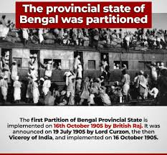
REASONS FOR THE PARTITION OF BENGAL
Religious Divide: The British also used religion as a justification for the partition. They argued that the Muslims of Bengal were a separate community from the Hindus and needed a separate administrative unit.
Strategic Reasons: The partition of Bengal was also seen as a way to provide strategic advantages to the British. The eastern region of Bengal was closer to the Chinese border, and separating it from the western region would make it easier to defend against potential Chinese incursions.
Linguistic Divide: The British also used language as a justification for the partition. They believed that the Bengali language was the cause of the growing nationalist movement and that separating the eastern region, which had a different dialect of Bengali, would help to weaken the movement.

Slide 12
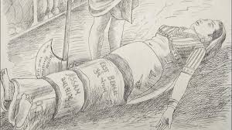
REACTION TO THE PARTITION OF BENGAL
There was widespread political unrest in the province after Curzon announced the partition.
Many people in Bengal regarded this partition as an insult to their motherland. There was a huge cry for the unity of Bengal. Rabindranath Tagore composed the famous song ‘Amar Sonar Bangla’ which later became the national anthem of Bangladesh.

Slide 13
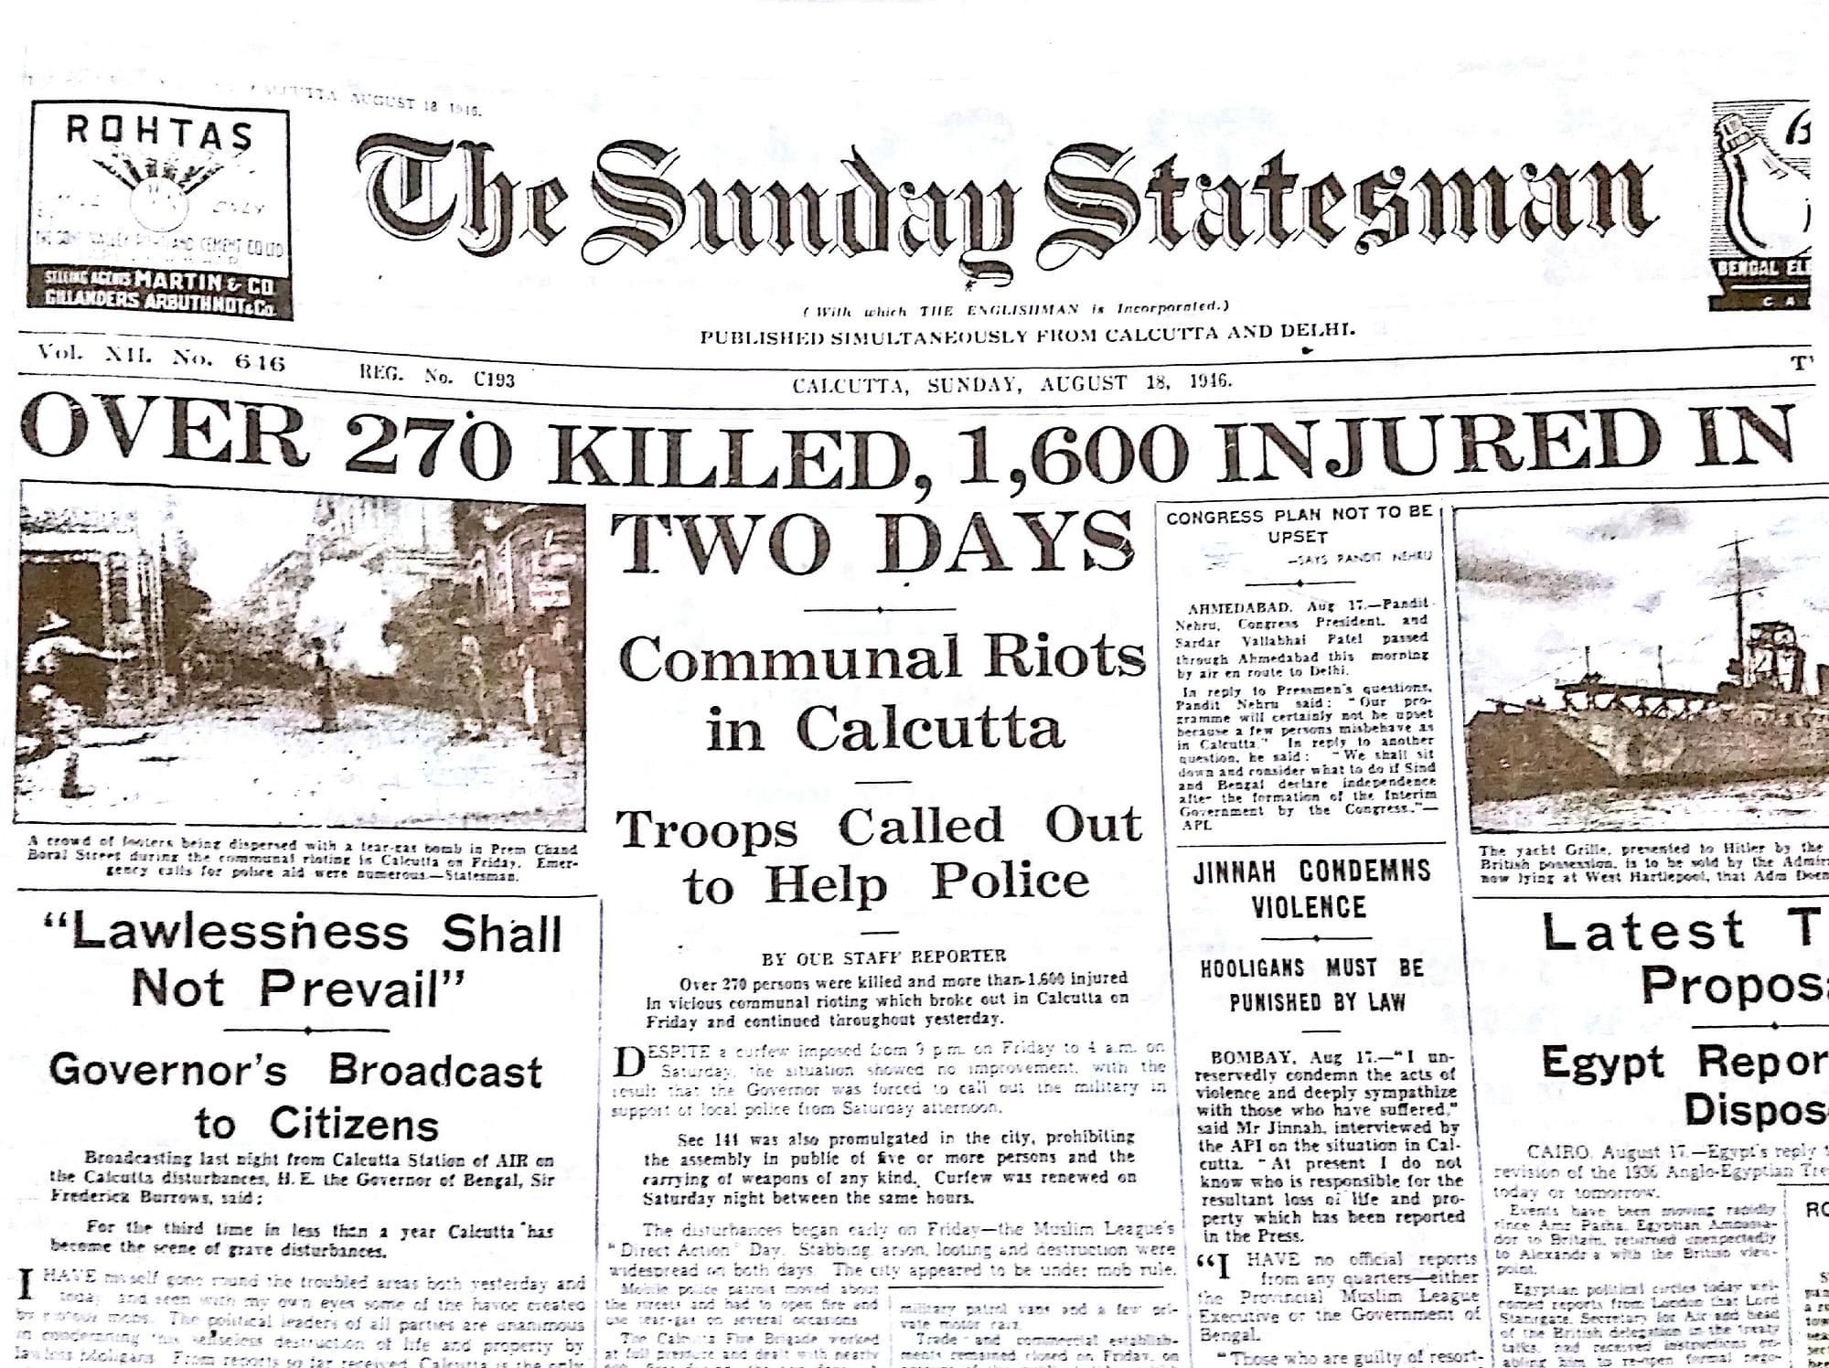
REACTION TO THE PARTITION OF BENGAL
The general protest in the rest of the country was against this partition. The people saw through the ‘divide and rule’ policy of the British authorities.
The chief aim of such a partition was only to create a rift between the two communities and hamper the unity and nationalism in the country.

Slide 14
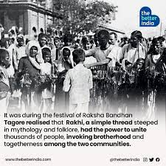
REACTION TO THE PARTITION OF BENGAL
The agitation had started much before the date of the partition itself. On the date of the partition, people observed a day of mourning. Tagore asked Hindus and Muslims to tie rakhis to each other as a mark of protest.
The Indian National Congress protested this move to separate the province on communal lines.

Slide 15

REACTION TO THE PARTITION OF BENGAL
Many Muslims from the Bengali Muslim community welcomed this move since they thought that it would advance their educational, economic, and political interests if they became the majority in the new province.
Lord Curzon also promised to start a university in Dhaka. This was also seen as an opportunity for Muslims to develop in education and improve their standard of living.

Slide 16
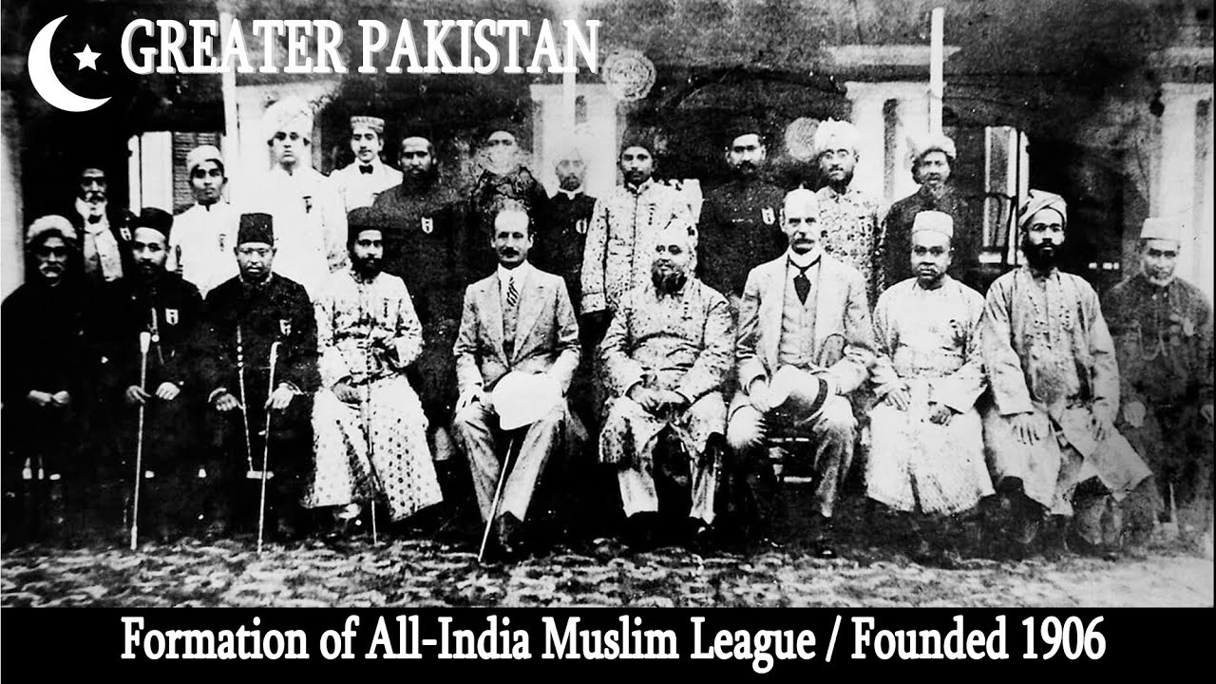
REACTION TO THE PARTITION OF BENGAL
The Swadeshi and Boycott movements in the national struggle started as a result of this partition.
People started boycotting British goods which had flooded the Indian market and had dealt a blow to the indigenous industry.
The partition did succeed in creating a communal rift in the country and even contributed to the birth of the Muslim League in 1906.

Slide 17
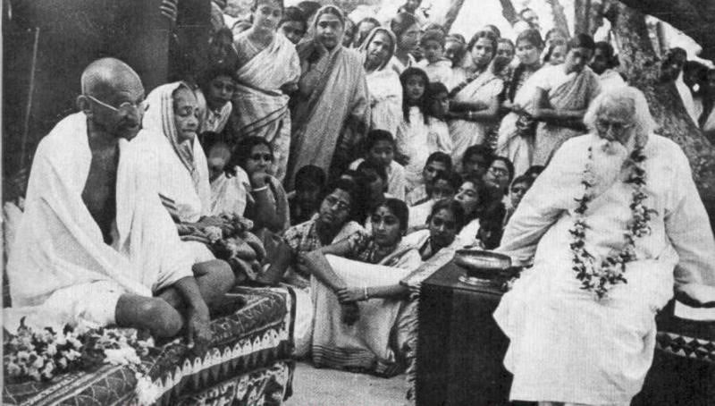
RESULT OF THE PARTITION OF BENGAL
Nationalist Movement: The partition of Bengal sparked a massive nationalist movement in India, with Indian leaders like Surendranath Banerjee and Rabindranath Tagore leading the protests. The movement unified Hindus and Muslims against the British and paved the way for India's independence.
Swadeshi Movement: The partition of Bengal also led to the Swadeshi Movement, which aimed at boycotting British goods and promoting Indian-made goods. The movement saw a surge in the use of indigenous products and contributed significantly to India's economic growth.

Slide 18
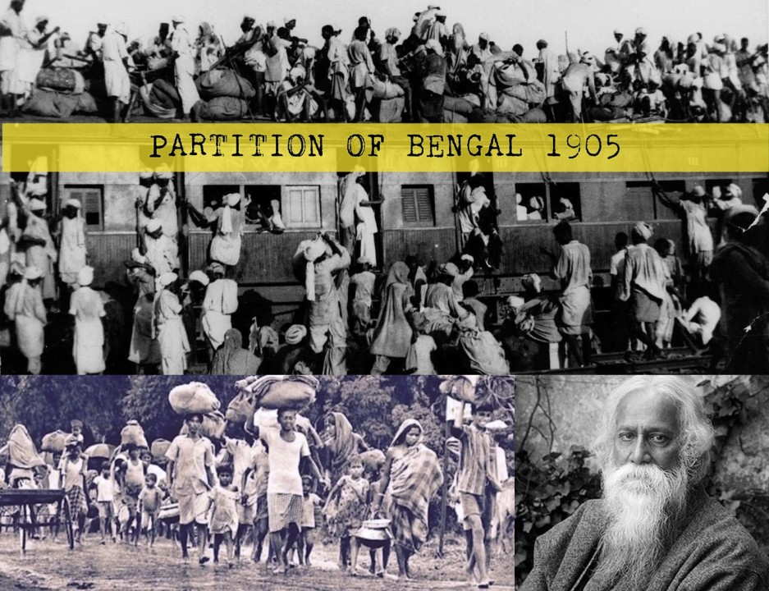
RESULT OF THE PARTITION OF BENGAL
Communal Tensions: The partition of Bengal created communal tensions between the Hindus and Muslims in the region. It led to the formation of the All-India Muslim League, which demanded separate electorates for Muslims.
Cultural and Linguistic Identity: The partition of Bengal created a new identity among Bengalis, who developed a strong sense of linguistic and cultural identity. The partition resulted in the creation of the new province of Eastern Bengal and Assam, which was later renamed East Bengal and then East Pakistan, and finally became the independent nation of Bangladesh.

Slide 19
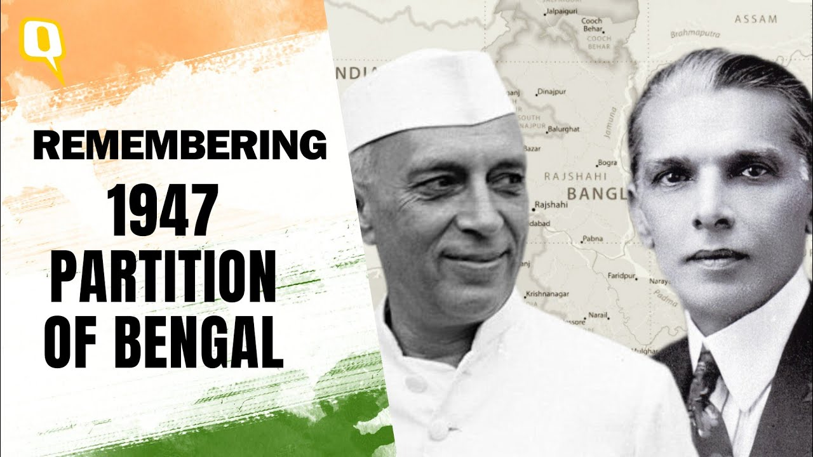
RESULT OF THE PARTITION OF BENGAL
Administrative Reforms: The partition of Bengal led to administrative reforms in India. The Indian Councils Act of 1909 expanded the Indian Legislative Council and increased the number of Indians in the council, giving Indians a greater voice in their governance.
Overall, the partition of Bengal had far-reaching consequences, and it served as a turning point in India's struggle for independence.

Slide 20

ANNULATION OF THE PARTITION OF BENGAL
The partition of Bengal was formally annulled on April 12, 1911, by King George V during his visit to India. The partition of Bengal was canceled by the British government in 1911. The decision was made primarily due to political pressure and protests from Indian leaders, who saw the partition as an attempt to divide and weaken the Indian independence movement. The leaders of the movement, including the Indian National Congress, organized widespread boycotts, protests, and strikes, which eventually forced the British government to revoke the partition. The decision was announced by the then Viceroy of India, Lord Hardinge, on December 12, 1911.

Slide 21
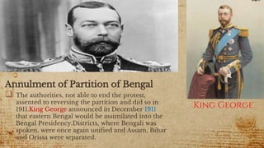
ANNULATION OF THE PARTITION OF BENGAL
New provinces were created based on linguistic lines rather than religious lines. Bihar and Orissa Province was carved out of Bengal. (Bihar and Orissa became separate provinces in 1936).
A separate Assam province was created.
The capital of British India was moved to Delhi from Calcutta in 1911.
Despite the annulment, the partition did create a communal divide among the Hindus and Muslims of Bengal.

Slide 22


